Slide 1
第6-4章: Classification and Prediction
Bayesian decision rule
Fisher linear discriminant analysis
SVM
Aggregating classifiers
Reference
T. R. Golub, D. K. Slonim, P. Tamayo, C. Huard, M. Gaasenbeek, J. P. Mesirov, H. Coller, M. L. Loh, J. R. Downing, M. A. Caligiuri, C. D. Bloomfield, E. S. Lander. Molecular Classification of Cancer: Class Discovery and Class Prediction by Gene Expression Monitoring. Science 15 October 1999: Vol. 286 no. 5439 pp. 531-537.
Ji Zhu and Trevor Hastie. Classification of gene microarrays by penalized logistic regression. Biostatistics (2004), 5, 3, pp. 427–443.
部分Slides来自于http://www.epibiostat.ucsf.edu/biostat/cbmb/courses/CBMBdiscrimination.ppt

Slide 2
Classification
Task: assign objects to classes (groups) on the basis of measurements made on the objects
Unsupervised: classes unknown, want to discover them from the data (cluster analysis)
Supervised: classes are predefined, want to use a (training or learning) set of labeled objects to form a classifier for classification of future observations

Slide 3
Supervised Classification (Two Classes)
Sample 1
. . . . . . .
Sample n
Gene 1
. . . . . . .
Gene p
Class 1
(Normal)
Class 2
(Tumor)

Slide 4
Example: Tumor Classification
Reliable and precise classification essential for successful cancer treatment
Current methods for classifying human malignancies rely on a variety of morphological, clinical and molecular variables
Characterize molecular variations among tumors by monitoring gene expression (microarray)
Hope: that microarrays will lead to more reliable tumor classification (and therefore more appropriate treatments and better outcomes)
Notes:
4

Slide 5
Tumor Classification Using Array Data
Three main types of statistical problems associated with tumor classification:
Identification of new/unknown tumor classes using gene expression profiles (unsupervised learning – clustering)
Classification of malignancies into known classes (supervised learning – discrimination)
Identification of “marker” genes that characterize the different tumor classes (feature or variable selection).
Notes:
4 relevant to other types of classification problems, not just tumors

Slide 6
Classifiers
A predictor or classifier partitions the space of gene expression profiles into K disjoint subsets, A₁, ..., A_{K}, such that for a sample with expression profile X=(X₁, ...,X_{G}) ∈ A_{k} the predicted class is k
Classifiers are built from a learning set (LS)
L = (X₁, Y₁), ..., (X_{n},Y_{n})
Classifier C built from a learning set L:
C( . ,L): X → {1,2, ... ,K}
Predicted class for observation X:
C(X,L) = k if X is in A_{k}

Slide 7
Bayes公式
后验概率:
先验概率: π_{k}, 其中Σπ_{k}=1.
Bayes公式

Slide 8
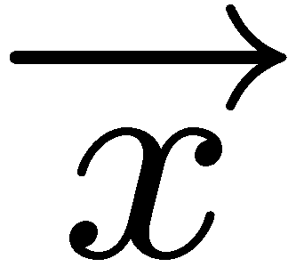
Bayes决策
将观测向量 归入后验概率最大的类，即
利用Bayes公式，上式等价于

Slide 9
最小错误Bayes决策
错误函数
单个类别的错误函数
其中Ω_{i}为归入类别ω_{i}的区域。

Slide 10
最小错误Bayes决策

Slide 11
最小错误Bayes决策
因此,为了使p(error)最小,只要选择区域Ω_{i},使得正确分类概率最大
Bayes决策使得正确分类概率最大
Bayes错分概率为

Slide 12
两类问题Bayes决策
对于一维观测量x, 最小错误率对应于如下的最优分界线下的错误率，
x
最优分界线

Slide 13
正态分布判别
对多元正态分布
按照Bayes原则,
.

Slide 14
正态分布判别
二次判别函数
判别规则是:若对所有的j≠ i有g_{i}>g_{j},则将样本归入ω_{i}.

Slide 15
正态分布判别分界面

Slide 16
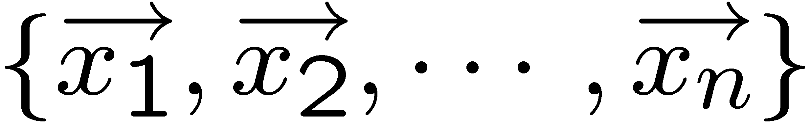
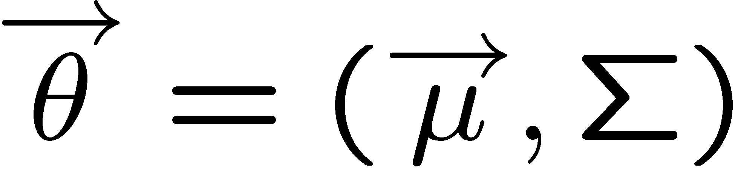
从数据估计参数
设有一组样本 ,其正态分布特征 ,那么似然函数
求log(L)对θ的微分得到,

Slide 17
从数据估计参数
这里用到公式
于是,极大似然估计为

Slide 18
正态分布二次判别函数
用估计值带入到判别函数,得到二次判别函数 (有时甚至用每个类型数据个数所占比例来估计先验概率)

Slide 19
正态分布线性判别函数
特别地,假定类协方差相等时,判别函数简化为线性函数,
其中S_{W}为共群协方差矩阵,其估计为

Slide 20
正态分布两类判别函数
对于两类问题,当类协方差相等时,判别函数有更简单的形式,
如果 , 将样本归入ω₁;否则归入ω₂, 其中

Slide 21
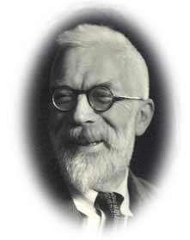
判别分析
最初由 R.A. Fisher提出.

Slide 22
Fisher判别分析
寻找一个投影方向，使得在该方向上
极小化组内距离。
极大化组间距离。
➔ 基本的目标在于提取最有效的分类特征
Notes:
IDEE

Slide 23
Fisher判别分析：分散矩阵
组间距
组内距

Slide 24
投影方向上的分散矩阵
投影变换u=α^{T}x
投影后组间距S_{B}(u)=α^{T}S_{B}α.
投影后组内距S_{W}(u)=α^{T}S_{W}α.

Slide 25
Fisher判别分析
Fisher准则：投影后的组间距和组内距比值最大，

Slide 26
投影方向求解
为保证唯一性，可以要求α满足，
采用Lagrange乘子法,变为下面的函数的优化问题

Slide 27
投影方向求解
目标函数对α, λ微分,
得方程

Slide 28
投影方向求解
求解特征值问题
S_{B}的秩最大为K-1，可以最多提取K-1个特征向量。

Slide 29
两类问题的Fisher判别分析
两类时的Fisher准则,
对J_{F}(α)微分得,
得

Slide 30
两类问题的Fisher判别分析
判别规则
和前面等协方差正态分布Bayes决策形式一样,有时候就取Bayes决策之阈值

Slide 31
两类问题的Fisher判别分析
2.0
1.5
1.0
0.5
B
.
.
.
.
.
.
.
.
.
.
A
.
.
.
0.5 1.0 1.5 2.0
.
.
w

Slide 32
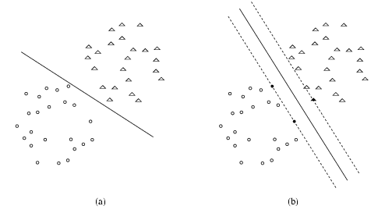
Find Optimal Hyperplane
Assumption: samples are linearly separable.
A better generalization is expected from (b).

Slide 33
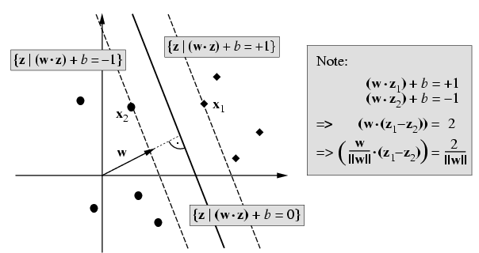
Geometric Margin

Slide 34
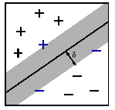
Maximal Margin Separation
Find hyperplane with the largest distance to closest samples.
Support vectors: samples with minimal distance.

Slide 35
Lagrange Theory with Inequality Constraints (Kuhn-Tucker)
The primal problem with convex domain Ω 2 R^{n} and f2C¹ convex and g_{i}, h_{i} affine.

Slide 36
Lagrange theory with inequality constraints (Kuhn-Tucker)
i.e. Finding α*, β* such that

Slide 37
Solving the Optimization Problem
Lagrangian function
Taking derivative,

Slide 38
Solving the Optimization Problem
Substituting the above relations into the Lagrangian function to obtain,

Slide 39
Dual Problem

Slide 40
The Solutions
Suppose α* is the solution of the dual problem, then
Only those support vectors z_{i} have no-zero α_{i}*, and

Slide 41
The Solutions
To classify a new sample z

Slide 42
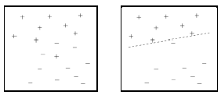
Nonseparable Training Samples
For some training samples, there is no separating hyperplance.
Complete separation is suboptimal for many training samples.
Minimize trade-off between margin and training error.

Slide 43
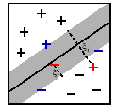
Soft-margin Separation
By introducing N nonnegative variables ξ₁,☹,ξ_{N}, such that
Slack variables ξ_{i} measures by how much example (z_{i}, y_{i}) fails to achieve a target margin.
ξ_{i} is an upper bound on the number of training errors.

Slide 44
Soft-margin Separation
Maximize margin and minimize training error simultaneously (1-norm soft-margin).
C is a parameter that controls trade-off between margin and training error.

Slide 45
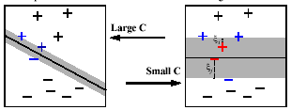
Soft-margin Separation

Slide 46
Solving the Optimization Problem

Slide 47
Dual Problem

Slide 48
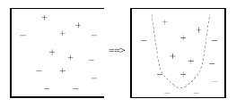
Nonlinear Problem
Some tasks have non-linear structure.
No hyperplane is sufficiently accurate.
How can SVMs learn nonlinear classification rules?

Slide 49
Extending the Hyperplane
Mapping the input samples to feature space in higher dimension.
Input Space
Feature Space
Finding the hyperplance in feature space.

Slide 50
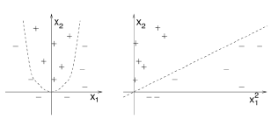
Example
Input space with two attributes: (x₁,x₂).
Feature space with 6 attributes: (x₁², x₂² , x₁, x₂ , x₁x₂ ,1)

Slide 51
Mercer’s Theorem
If K is a continuous kernel of a positive definite integral operator on L₂(X) (where X is some compact space).
Then there exists a mapping Φ to a high dimension space H, such that K(x,x⁰) is the inner product in H.

Slide 52
Kernels
The dual problem depends only on inner products, so we do not need to represent the feature space explicitly. Only the inner product in feature space need to be considered.

Slide 53
SVM With Kernels
Defined by the dual problem with 1-norm soft margin.

Slide 54
Kernels Choice
Linear:
Polynomial:
Radial basis functions:
Sigmoid:

Slide 55
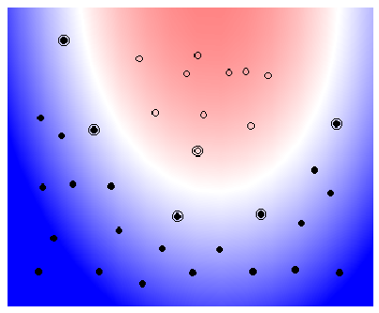
Example: Polynomial Kernel

Slide 56
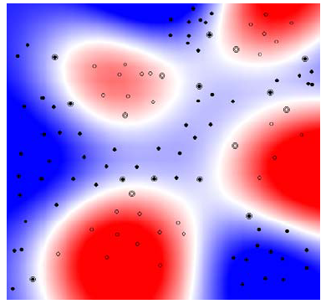
Example: Radial Basis Function (RBF) Kernel

Slide 57
What is a valid kernel?
Definition: Let X be nonempty set. A function K(x_{i},x_{j}) is a valid kenel in X if for all n and all
it produces a Gram matrix
That is symmetric and positive semi-definite.

Slide 58
How to Construct a Valid Kernel
Theorem: Let K₁ and K₂ be valid kernels over ,
f a real-valued function on X, φ is a map
from X to R^{m} with K₃ a kernel over , and G a
symmetric positive semi-definite matrix, then the following
functions are valid kernels

Slide 59
Multiple Classes Problem
To obtain a k-class classifier, we con-struct a set of binary classifiers f¹,☹, f^{k}, each trained to separate one class from the rest, and combine them by doing the multiple-class classification according to the maximal output before applying the sign function.

Slide 60
Multiple Classes Problem
Taking,
These values can also be used to reject decisions, for instance by considering the difference between the maximum and the second highest value as a measure of confidence in the classification.

Slide 61
Why does SVM work well
Measurement: the risk of misclassifying of training samples and test samples (generalization problem).
Principle: structural risk minimization.
Key concept: VC dimension.

Slide 62
VC (Vapnik-Chervonenkis) Dimension
Definition: the VC dimension for a set of function f(α) is defined as the maximum number of training points that can be shattered by H={f(α)}.
Shattered: if a given set of N points can be labeled in all possible 2^{N} ways, and for each labeling, a number of the set {f(α)} can be found which correctly assigns those labels, we see that the set of points is shattered by that set of functions.

Slide 63
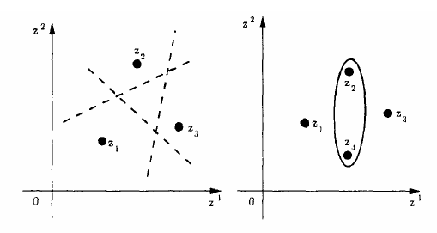
Example
VC dimension for lines in the plane is 3.
The VC dimension of a set of oriented hyperplane in R^{n} is n+1

Slide 64
Example: Infinite VC Dimension
f(x, α)=sgn(sin αx) can shatter arbitrary points.
So the VC dimension of these function is infinite.

Slide 65
Expected Risk
Given N observation { (z_{i},y_{i}), i=1,2,…,N }, and assume these observations are drawn from some unknown probability distribution P(z,y). Suppose a classifier gives prediction f(z,α) for each z. The expectation of the test error for the classifier is called as expected risk,

Slide 66
Empirical Risk
The empirical risk R_{emp} is

Slide 67
Relation Between Two Risks
Under certain model, Vapnik proved the bound for the expected risk which holds with probability 1-η.
Where h is the VC dimension of f(z,α), and the second term on the right hand size is called VC confidence.

Slide 68
Other Classifiers Include…
Decision tree (CART, C4.5)
Neural networks
Nearest neighbour (KNN)
Logistic regression
Projection pursuit
Bayesian belief networks

Slide 69
Measuring the Accuracy of the Classifier
Hold-out test
Hold a certain fraction of samples for test.
Leave one out cross-validation
K-fold cross-validation
将数据集分为k个子集；
用k-1个子集作训练集，1个子集作测试集，然后k次交叉验证；

Slide 70
Measuring the Accuracy of the Classifier
 | Real Negative | Real Positive
Claimed Positive | False Positve (FP) | True Positive (TP)
Claimed Negative | True Negative (TN) | False Negative (FN)

Slide 71
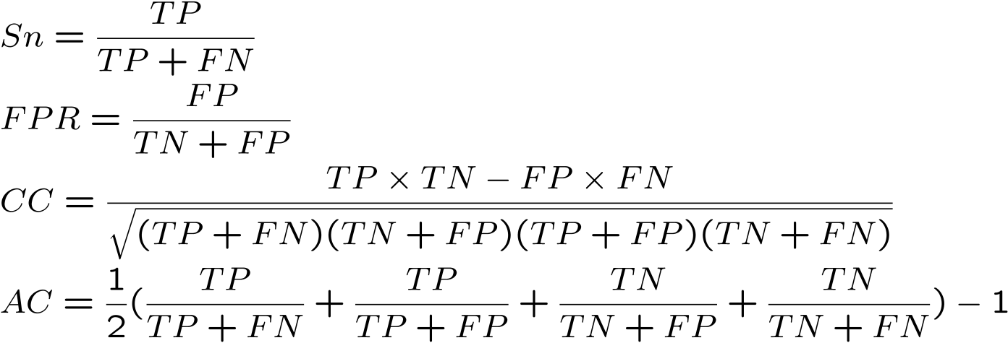
Measuring the Accuracy of the Classifier
Sensitivity (Sn)
False Positive Rate (FPR)
Correlation Coefficient (CC)
Approximate Correlation (AC)

Slide 72
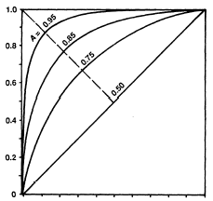
Measuring the Accuracy of the Classifier
ROC: Receiver Operating Characteristic or Relative Operating Characteristic. True positive proportion v.s. False-positive proportion.

Slide 73
Aggregating classifiers
Breiman (1996, 1998) found that gains in accuracy could be obtained by aggregating predictors built from perturbed versions of the learning set; the multiple versions of the predictor are aggregated by voting.
Let C(., L_{b}) denote the classifier built from the bth perturbed learning set L_{b}, and let w_{b} denote the weight given to predictions made by this classifier. The predicted class for an observation x is given by
argmax_{k} ∑_{b} w_{b}I(C(x,L_{b}) = k)

Slide 74
Diagram of aggregating classifiers
Sample1
classifier1
Sample2
classifier2
Training
Set:
X1 …X100
Aggregated
classifier
Test set
dot dot dot
dot dot dot
Sample499
classifier499
Sample500
classifier500

Slide 75
Bagging
Bagging = Bootstrap aggregating
Non-parametric Bootstrap (standard bagging): perturbed learning sets drawn at random with replacement from the learning sets; predictors built for each perturbed dataset and aggregated by plurality voting (w_{b} = 1)
Parametric Bootstrap: perturbed learning sets are multivariate Gaussian
Convex pseudo-data (Breiman 1996)

Slide 76
Boosting
Freund and Schapire (1997), Breiman (1998)
Data resampled adaptively so that the weights in the resampling are increased for those cases most often misclassified
Predictor aggregation done by weighted voting

Slide 77
Random Forests
Perturbed learning sets are drawn at random with replacement from the learning sets
The exploratory tree is built for each perturbed dataset in a way that at each node, the pre-specified number of features is randomly sub-sampled without replacement and only these variables are used to decide the split at that node.
The resulting trees are aggregated by plurality voting (w_{b} = 1)

